Slide 1
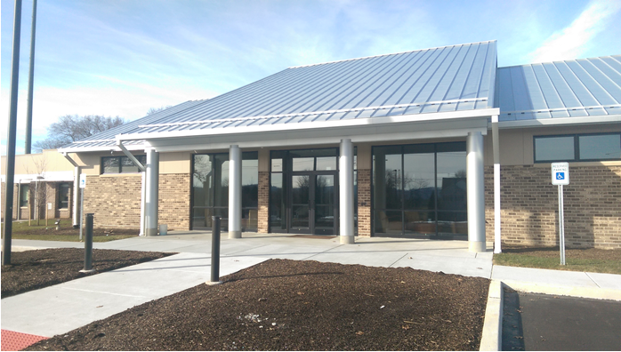
2026 General Fund
East Donegal Township

Slide 2
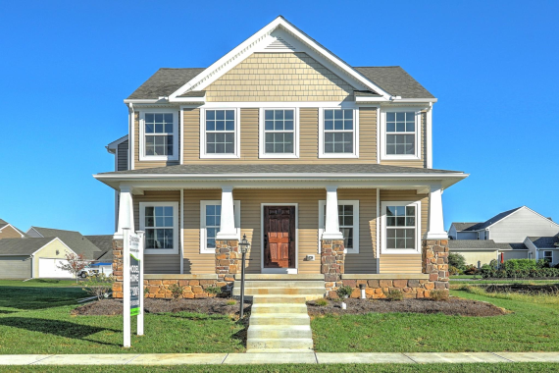


Budget Overview
2026 Projected Total Revenue - $5,839,563.00
2026 Projected Total Expenditures - $5,816,470.27
Millage 3.1165 (No Change)
2026 Budget

Slide 3
General Fund - Revenue
Real Estate Taxes
New Taxable Assessment- $698,551,700
Collected By Lancaster County Treasurer’s Office
1 Mil = $698,551.70
Projected Revenue From Property Tax - $2,156,000.00
Represents Approximately 37% of Revenue
Assessment $200,000 = $623.30 Tax Bill
2026 Budget

Slide 4

General Fund - Revenue
Local Tax Enabling Act (35% Of Revenue)
2026 Earned Income Tax - $1,713,400.00
2026 Real Estate Transfer Tax - $180,000.00
2026 Local Services Tax - $142,800.00
2026 Budget

Slide 5
General Fund - Revenue
Inter-fund Transfers
Trash and Recycling - $75,000.00
Park and Recreation - $50,000.00
Capital Reserve - $66,232.00
Emergency Services Capital Reserve - $106,401.00
EDTMA Fund - $356,760.00
PennDOT Green Light-Go Grant - $331,850.00
Route 441/Route 743 Intersection
2026 Budget

Slide 6

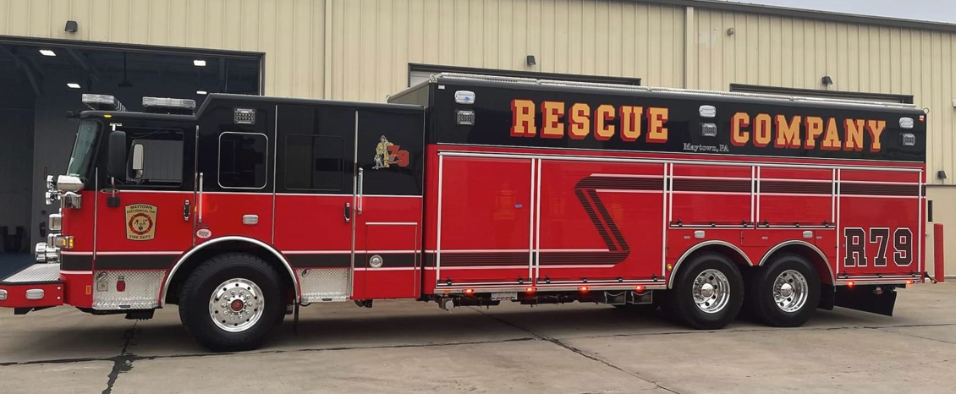
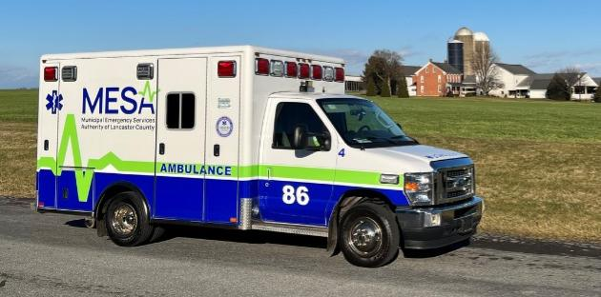
General Fund - Expenditures
Public Safety
Public Safety-Police line items total $2,151,080.00 (37% of Expenditures)
Public Safety-Fire line items total $510,145.58
Emergency Management and Ambulance line items total $29,422.00
2026 Budget

Slide 7
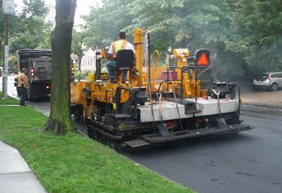
General Fund - Expenditures
Public Works - $1,163,250.00
Maytown Alleys
Green Light Go Grant Match
Crosswalk Painting
Engineering & Design Vinegar Ferry Road Bridge
Traffic Signal Repairs
Stormwater Management
Reline Vinegar Ferry Road Drains
2026 Budget

Slide 8
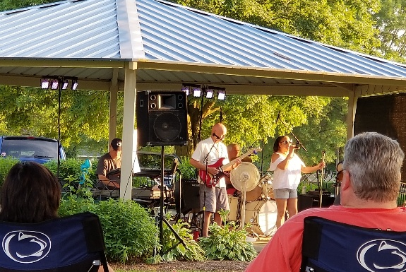
General Fund - Expenditures
Parks and Recreation
Parks and Recreation total $235,785.00
Projects
Replace UTV
Fuhrman Park New Roof on Kitchen Pavilion
Bridle Path resurface Basketball and Tennis Court
Programs
GEARS – Municipal Membership
Music In The Park
2026 Budget

Slide 9
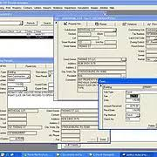
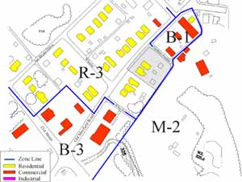
General Fund - Expenditures
Planning/Zoning and Code Enforcement
Planning/Zoning and UCC Code Enforcement line items total $94,050.00
2026 Budget

Slide 10
General Fund - Expenditures
Debt Service
Tractor/Road Bank Mower - $42,970.84
Contributions
Milanof-Schock Library- $44,000
Maytown Historical Society - $6,500
Memorial Day Parade - $4,500
2026 Budget

Slide 11
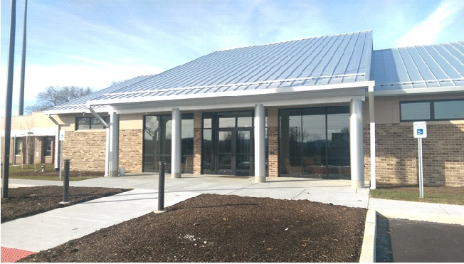
Employee Wages - Expenditures
Wages for full-time and part-time employees represent $533,397.80 (9% of General Fund)
3% wage increase for employees
2026 Budget

Slide 12
Where Your Property Tax Dollars Go
Millage Rates
East Donegal Township – 3.1165
Lancaster County – 2.911
Donegal School District – 20.2424
MILLAGE RATES FOR 2025 COUNTY-MUNICIPAL & 2025-26 SCHOOL Lancaster County Property Assessment Office
2026 Budget

Slide 13
Where Your Property Tax Dollars Go
Tax Assessed ($200,000)
East Donegal Township – $623.30
Lancaster County – $582.20
Donegal School District – $4,048.48
Total - $5,253.98
2026 Budget

Slide 14
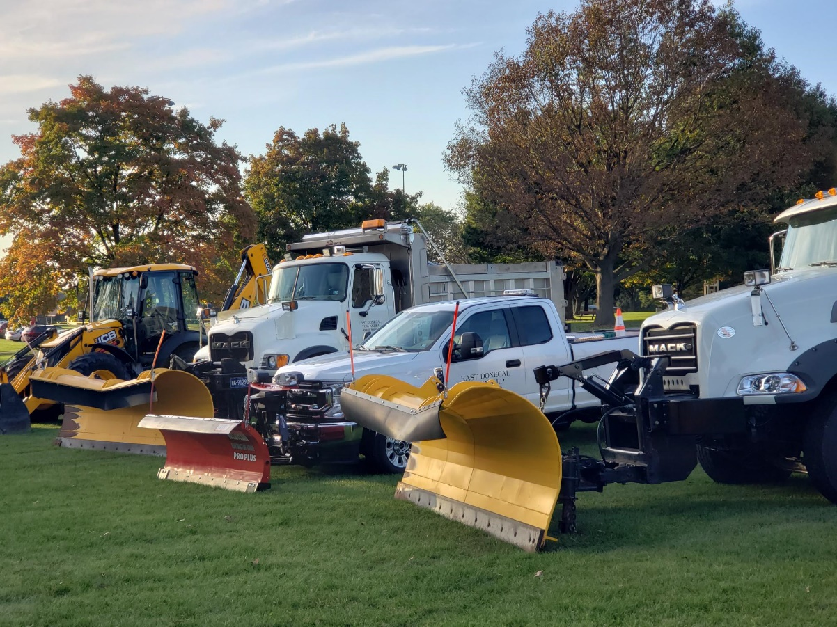
2026 Highway Aid Fund
East Donegal Township

Slide 15
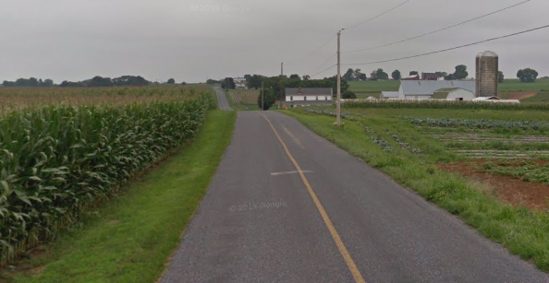

Highway Aid Fund
Highway Aid Expenditures: $973,000.00
Donegal Springs Road (Church Entrance to Maytown Rd)
Oil and Chip
Airport Rd
Iron Bridge Rd
Nissley Rd
Winter Salt
Line Painting
2026 Budget

Slide 16
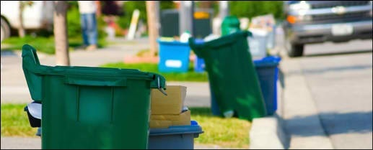
2026 Trash & Recycling Fund
East Donegal Township

Slide 17
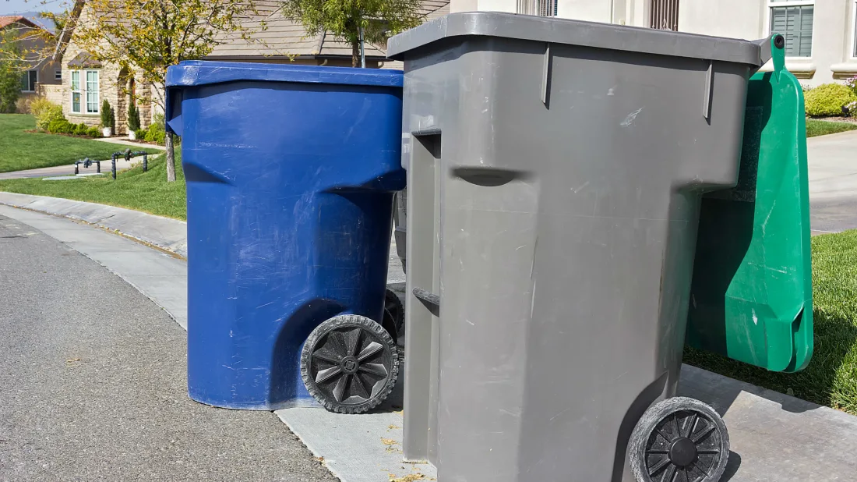
Trash/Recycling Fund
Contract Hauler Cost Increase
3% Increase from Previous Contract Year
LCSWMA Tipping Fee Increases
Proposed Rate Increase to $346.00
$16.00 increase this year = $8.00 per semi-annual billing
2026 Budget

Slide 18
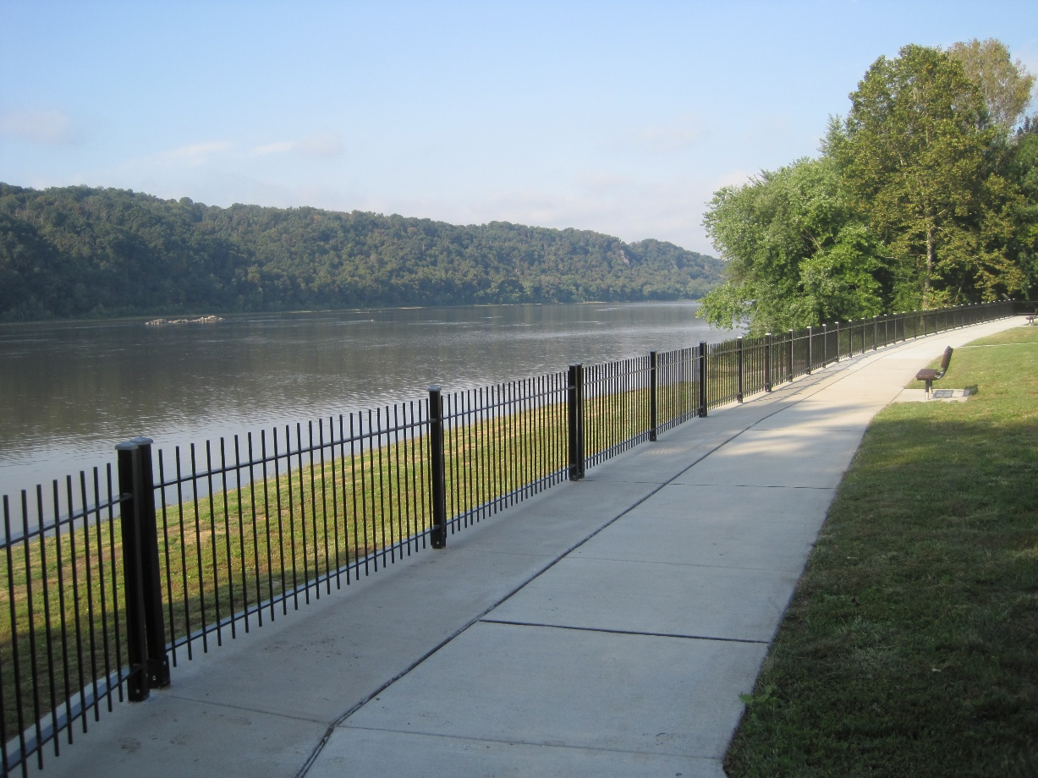
2026 Budget
East Donegal Township

