Slide 1
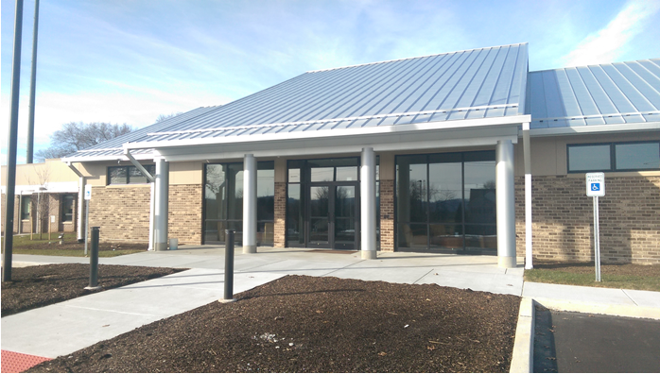
2027 General Fund
East Donegal Township

Slide 2
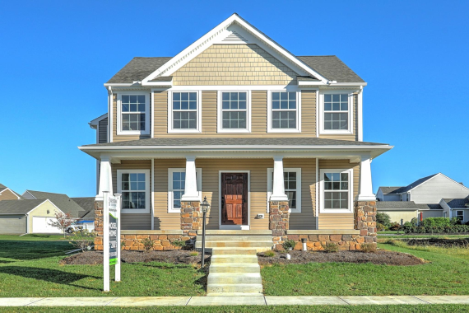


Budget Overview
2027 Projected Total Revenue - $5,957,361.00
2027 Projected Total Expenditures - $5,950,936.20
Millage will be revenue neutral
2027 Budget

Slide 3
General Fund - Revenue
Real Estate Taxes
  New Taxable Assessment- $1,164,004,900.00 as of November 2,2026
          Collected By Lancaster County Treasurer’s Office
          Projected Revenue From Property Tax - $2,156,000.00
          Represents Approximately 36% of Revenue
          Assessment $200,000 = $623.30 Tax Bill
2027 Budget

Slide 4

General Fund - Revenue
Local Tax Enabling Act (37% Of Revenue)
  2027 Earned Income Tax - $1,847,000.00
  2027 Real Estate Transfer Tax - $195,000.00
  2027 Local Services Tax - $148,000.00
2027 Budget

Slide 5
General Fund - Revenue
  Inter-fund Transfers
    Trash and Recycling - $50,000.00
    Park and Recreation - $73,500.00
    Capital Reserve - $23,516.00
    Emergency Services Capital Reserve - $53,000.00
    EDTMA Fund - $356,760.00
  PennDOT Green Light-Go Grant - $344,160.00
  ** Route 441and Route 772 Multiply Intersections
2027 Budget

Slide 6

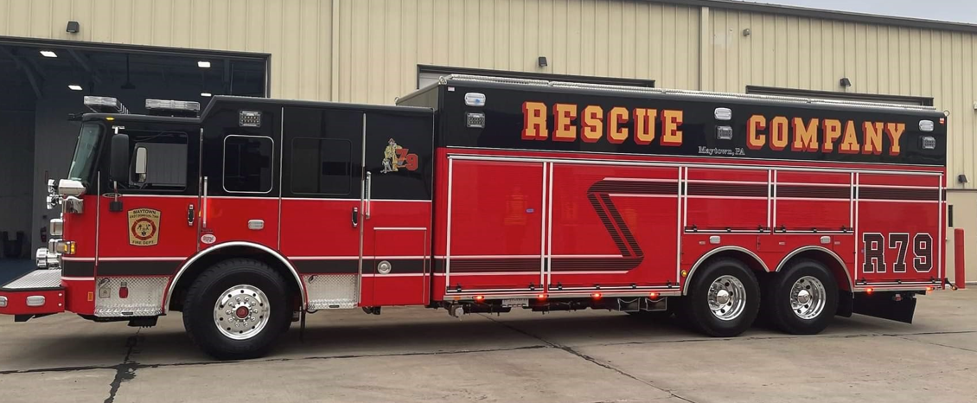
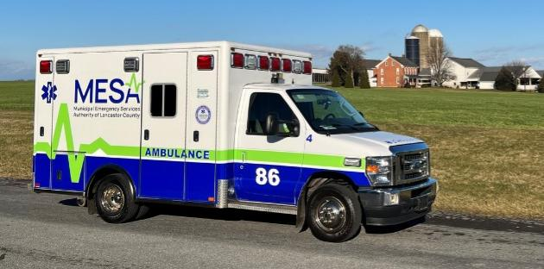
General Fund - Expenditures
  Public Safety
    Public Safety-Police line items total $2,151,580.00 (37% of Expenditures)
    Public Safety-Fire/EMS/EMA line items total $597,101.35 (10% of Expenditures)
2027 Budget

Slide 7
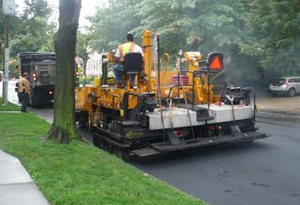
General Fund - Expenditures
Public Works - $812,676.00
  Maytown Alleys
  Green Light Go Grant Match
  Base repair on roads as needed
  Crosswalk Painting
  Traffic Signal Repairs
  Stormwater Management
    Reline Vinegar Ferry Road Drains
2027 Budget

Slide 8
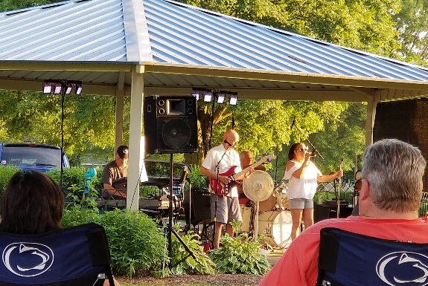
General Fund - Expenditures
Parks and Recreation
  Parks and Recreation total $264,575
    Projects
            Disc golf at Chickies Park
            Fuhrman Park - New roof on concession pavilion
            Legion Park - Resurface tennis court
    Programs
            GEARS – Municipal Membership
            Music In The Park
2027 Budget

Slide 9
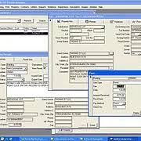
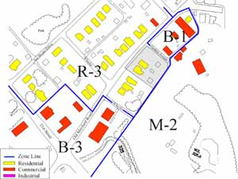
General Fund - Expenditures
Planning/Zoning and Code Enforcement
  Planning/Zoning and Code Enforcement line items total $114,925.00
2027 Budget

Slide 10
General Fund - Expenditures
Contributions
  Milanof-Schock Library- $44,000
  Maytown Historical Society - $6,500
  Memorial Day Parade - $4,000
2027 Budget

Slide 11
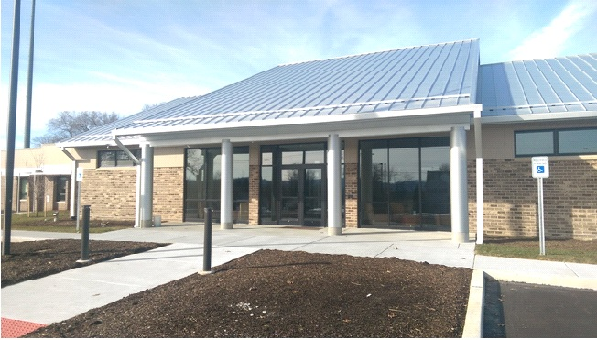
Employee Wages - Expenditures
  Wages for full-time and part-time employees represent $563,691.79 (9% of General Fund)
          3.25% wage increase for employees
2027 Budget

Slide 12
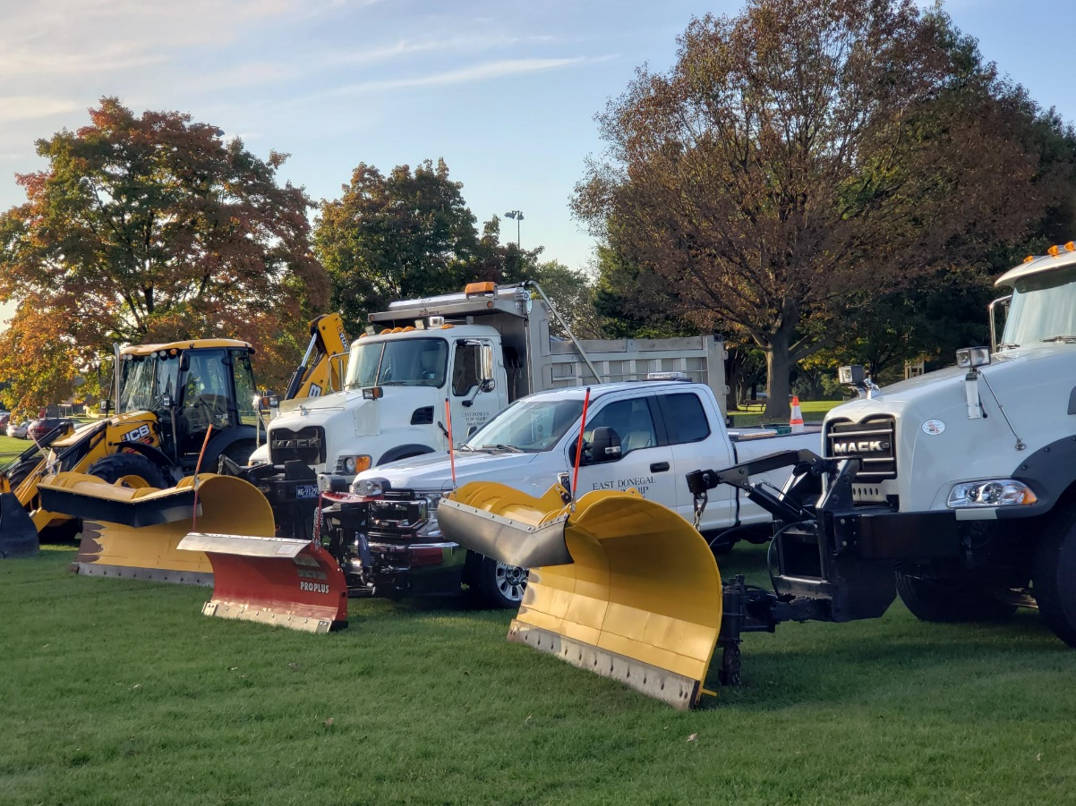
2027 Highway Aid Fund
East Donegal Township

Slide 13
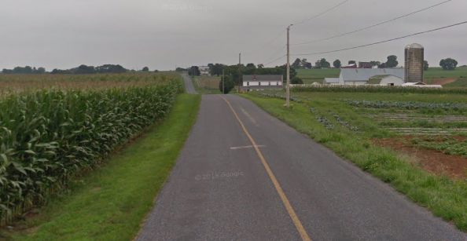

Highway Aid Fund
    Highway Aid Expenditures: $546,600.00
            Ultra Thin Bonded Wearing Course
            Donegal Heights Development (8 streets)
            Oil and Chip
              Bullmoose Road
              Hauenstein Road
            Winter Salt
            Line Painting
            Purchasing a Skid Loader and Milling Head
2027 Budget

Slide 14
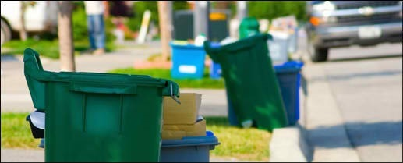
2027 Trash & Recycling Fund
East Donegal Township

Slide 15
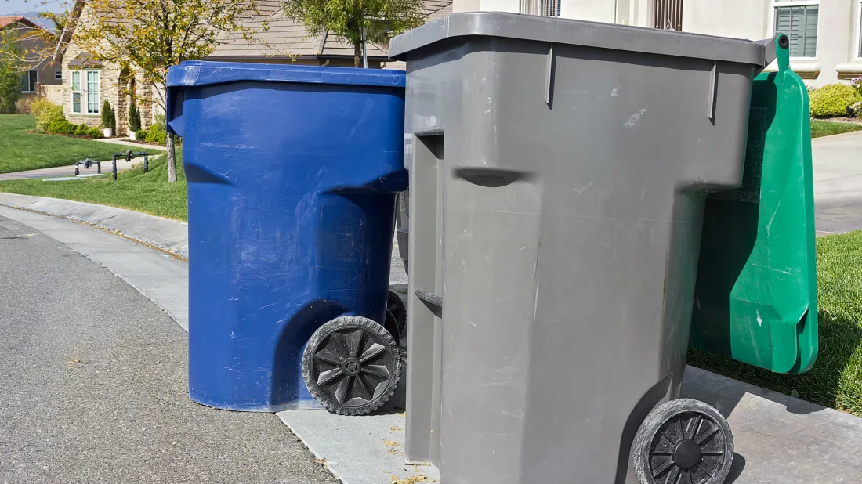
Trash/Recycling Fund
  Contract Hauler Cost Increase
  5.23% Increase from Previous Contract Year
  LCSWMA Tipping Fee Increases
  Proposed Rate Increase to $358.00
  $12.00 increase this year = $6.00 per semi-annual billing
2027 Budget

Slide 16
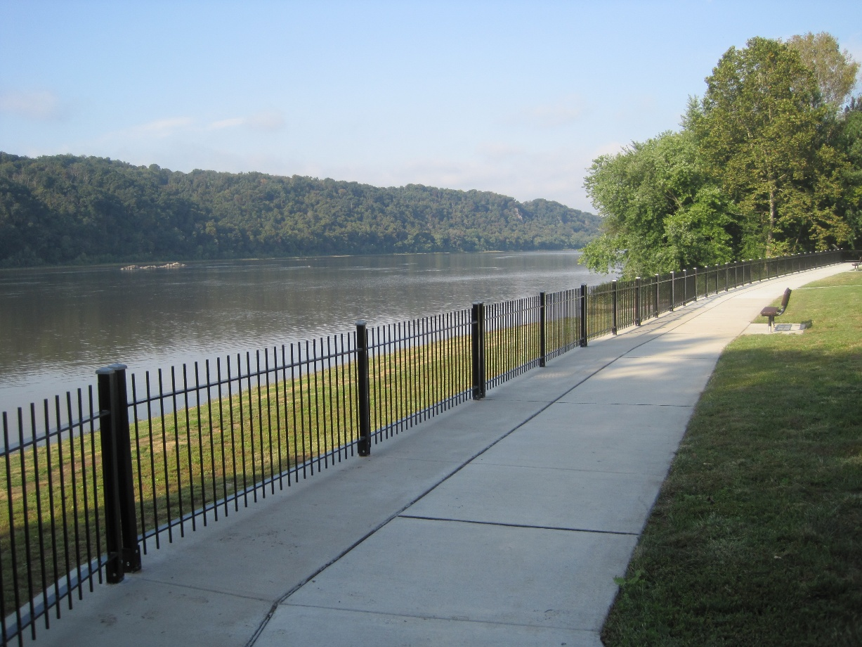
2027 Budget
East Donegal Township

